Slide 1
Crowdfunding
    Post-Completion Next Steps (A Legal Perspective)
      Presentation under the BLUE CROWDFUNDING project
      9 February 2021 .

Slide 2
Crowdfunding – Post-completion Issues
Contents
 | 01 General
 | 02 Corporate / Capital Markets Issues
 | 03 e-commerce Issues
 | 04 GDPR / Privacy Issues
 | 05 Consumer Protection Issues
 | 06 Taxation Issues

Slide 3

Potential
Post-Completion Legal Concerns

Slide 4

Post-Completion Concerns
General
Crowdfunding has seen explosive growth in all areas and industries over the last few years globally
This new way of capital raising has led to increased regulation in most western jurisdictions / economies
A project owner needs to be weary of a plethora of legal issues that may arise post-completion and a variety of statutory and other obligations and duties that his business must adhere to and diligently honour
Company Value, Other Point or Expected Outcome
Post-completion concerns / obligations may range from corporate, capital markets, e-commerce, privacy and GDPR, consumer protection and competition-related issues, etc.

Slide 5

Post-Completion Concerns
Corporate / Capital Markets Issues
Subscription mechanics – what kind of shares: voting, non-voting, preference shares?
SHA required? Changes in M&AAs? Dilution procedures?
NDAs to be put in place?
Exit-strategy proofing for investors – pre-emption rights / rights of first refusal
To Plc or Not to Plc - Prospectus Regulation (EU) 2017/1129 on the prospectus to be published when securities are offered to the public or admitted to trading on a regulated market may apply where we have an equity crowdfunding targeting the public
Corporate authorisations
IP protection

Slide 6

Post-Completion Concerns
e-commerce issues
The Law relating to certain legal aspects of information society services, in particular electronic commerce and pertinent matters, L. 156 (I)/2004 transposing Directive 2000/31/EC into national law
Regulates service providers: “any natural or legal person providing an information society service.”
“Service providers” must render easily, directly and permanently accessible to the recipients of the service and competent authorities with the following general information:
their names;
their geographic address;
Their details, including an email allowing the recipient to be contacted rapidly and communicated with directly and effectively;

Slide 7

Post-Completion Concerns
e-commerce issues
Its registration number or equivalent public register means of identification;
the particulars of any supervisory authority regulating the service provider, if applicable;
its VAT identification number, where applicable;
prices should be indicated clearly and unambiguously and must indicate whether they are inclusive of tax and delivery costs.
Additionally, the Law regulates promotional offers, such as discounts, premiums and gift offerings by the service provider as well as promotional competitions or games – must be clearly identifiable and the participation conditions must be easily accessible and presented clearly and unambiguously

Slide 8
Post-Completion Concerns
e-commerce issues
“established service provider” is one who effectively pursues an economic activity using a fixed establishment for an indefinite period.
Technical means and technologies on their own would not suffice: preparatory or auxiliary activities / functions threshold test applies.
Service provider must clearly, comprehensively and unambiguously give the following information in a pre-contractual context and prior to any order placed:
the different technical steps to conclude the contract;
whether the concluded contract will be filed with the service provider and be accessible;
the technical means for identifying and correcting input errors prior to placing the order; and
The languages offered for the conclusion of the
contract.

Slide 9
Post-Completion Concerns
e-commerce issues
The Law also regulates:
unsolicited commercial communications by electronic mail, treatment of contracts by electronic means;
the placing of the order procedure (acknowledgment of receipt of order by electronic means, accessible and without delay);
“caching” (automatic, intermediate and temporary storage of consumers’ information) hosting and spamming; and
the establishment of service providers, commercial communications, electronic contracts, liability of intermediaries, codes of conduct, out-of-court dispute settlements and court actions

Slide 10

Post-Completion Concerns
GDPR / Privacy Issues
Protection of privacy and personal data
The General Data Protection Regulation protects the information relating to an identified or identifiable natural person – one who is identified or may be identified by reference to their data (e.g. names, email address, identity card / passport or telephone number)
Processing of personal data is regulated and the processing of sensitive data (race, ethnic origin, political views, religious / philosophical beliefs, trade union membership, biometric data, sex life or sexual orientation date) is prohibited
“Processing” includes the collection, recording, organizing, structuring, storing, adapting, altering, retrieving, using, disclosing by transmission, disseminating or otherwise making available, erasing or destroying of personal data

Slide 11
Post-Completion Concerns
GDPR / Privacy Issues
Processing of personal data must adhere to processing principles (processing to be done lawfully, fairly and transparently, processing must be accurate and kept up to date, where necessary and data must be kept in a form which permits identification of data subjects for no longer than is necessary)
Processing must be done in a manner ensuring appropriate security of the data and protects against unauthorised or unlawful processing or accidental loss, destruction or damage
“Controller” and “Processor” are distinct roles: the first determines the purpose and means of processing the data while the second processes the data on behalf of the first.

Slide 12
Post-Completion Concerns
GDPR / Privacy Issues
Processing may take place only if a lawful basis can be identified to support it, for example:
when the data subject gives his or her consent (free, specific, informed and unambiguous indication of data subject’s wishes);
processing is necessary for contract performance or for the entry into a contract;
when necessary for compliance with a legal obligation of the controller;
when necessary for the pursuance of a legitimate interest by the controller or a third party

Slide 13
Post-Completion Concerns
GDPR / Privacy Issues
Businesses must have privacy notices as well as standard documentation informing the data subjects as to their processing practices
Procedures for holding employee personal data must be in place and GDPR compliant
DPO – Data Protection Officer (with expert knowledge in this area) must be appointed by some controllers / processors – May be outsourced to third party service providers
Record keeping by controllers / processors of processing activities containing certain information and be available to regulator

Slide 14
Post-Completion Concerns
GDPR / Privacy Issues
Data transfers outside EU – transfers to third countries recognised as offering adequate protection are permitted without authorisation. Otherwise, the controller / processor must show to have implemented safeguards (Standard Contractual Clauses – noting recent developments under Schrems II) and ensure that effective legal remedies are available

Slide 15
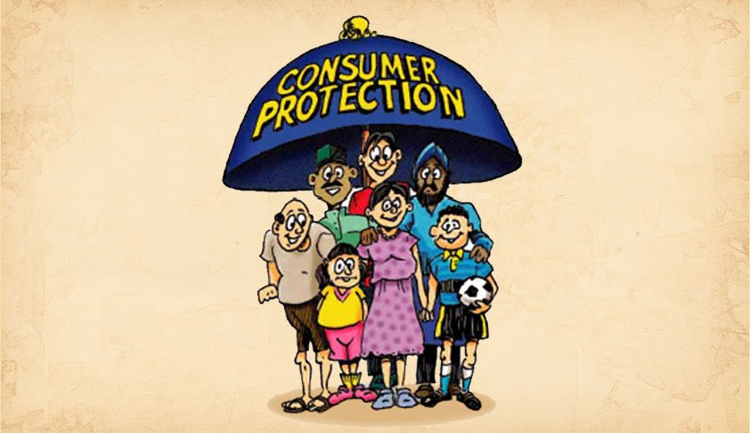
Post-Completion Concerns
Consumer Protection Issues
Law relating to Consumers’ Rights, L. 133(I)/2013 transposing Directive 2011/83/EU on consumer rights, as amended
Applies to any contract between a trader and a consumer.
Regulates, amongst others, consumer contracts, distance selling / off-premises contract (special, formal requirements apply), including cross border transactions to protect consumers, and commercial guarantees
Includes duty on trader to clearly and comprehensively inform the consumer with basic information in relation to the service or goods on offer

Slide 16
Post-Completion Concerns
Consumer Protection Issues
Also regulates the pre-contractual information requirements that a consumer needs to provide a consumer in a contract that is not a distance or an off-premises contract, in a clear and comprehensible manner, and which include:
the main characteristics of the goods or services;
the identity of the trader (including the geographical address, telephone number and trading / business name);
total price of goods / services inclusive of taxes;
arrangements for payment, delivery and performance and the timeframes for these, contract duration, etc.
The Law also regulates the pre-contractual (enhanced) information requirements that a consumer needs to provide a consumer in a distance or an off-premises contract.

Slide 17
Post-Completion Concerns
Consumer Protection Issues
The Law also regulates the pre-contractual (enhanced) information requirements that a consumer needs to provide a consumer in a distance or an off-premises contract.
Includes special consumer rights such as the absolute right of withdrawal within a period of 14 days without giving any reason or incurring any cost – applies to distance selling / off-premises contracts

Slide 18

Post-Completion Concerns
Taxation Issues
Direct Taxation
Corporate tax
Permanent establishment / Economic substance important for direct taxation and Cypriot tax residency status
Stamp Duty - Levied on ‘documents’ relating to assets located, and/or matters or things taking place, in Cyprus. International transactions NOT involving assets situated in Cyprus are, usually, exempt .
Indirect Taxation
VAT
Import / Export taxes - Brexit
Duty to maintain books and records

Slide 19



Crowdfunding – Post-completion Queries
Who to contact
George Apostolou
  Partner | Harneys Cyprus
    +357 2584 4313 / +357 99 400 333
    george.apostolou@harneys.com
        George Apostolou is a partner in our Cyprus office, where he specialises in the areas of financial services and regulatory law, corporate and commercial laws, banking and finance, private equity and trusts as well as project and asset finance transactions and security structures.

