Slide 1
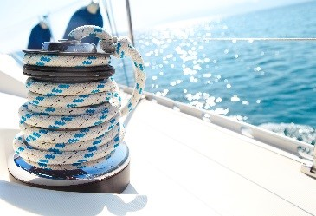

3-PBM methodology Theory session
Limassol 19.09.2019.
Lucia Cicero & Katia Richomme-Huet

Slide 2
Session 1 Theory session
Introduction in 3-Pillar Business Model (3PBM) methodology (mentored by Katia Richomme Huet and Lucia Cicero)
- Strategic importance of balanced business model – financial, social and environmental
- Business Model Canvas – leading framework for business model innovation and management
- Strategic perspective of Resources-Processes-Values framework
- Key 3PBM tools
- From theory to practice: The case of Cypriot pilot actions (Michalis Maimaris, Philip Ammerman)

Slide 3
Session 2 Practice and case studies session
Practical workshop for participating companies: hands-on implementation of 3-PBM methodology on real business case studies (mentored by Michalis Maimaris and Philip Ammerman)
- Initial business model analysis
- Business model impact analysis
- Identification of key trends and possibilities for company performance improvement based on 3-PBM sustainability methodology

Slide 4
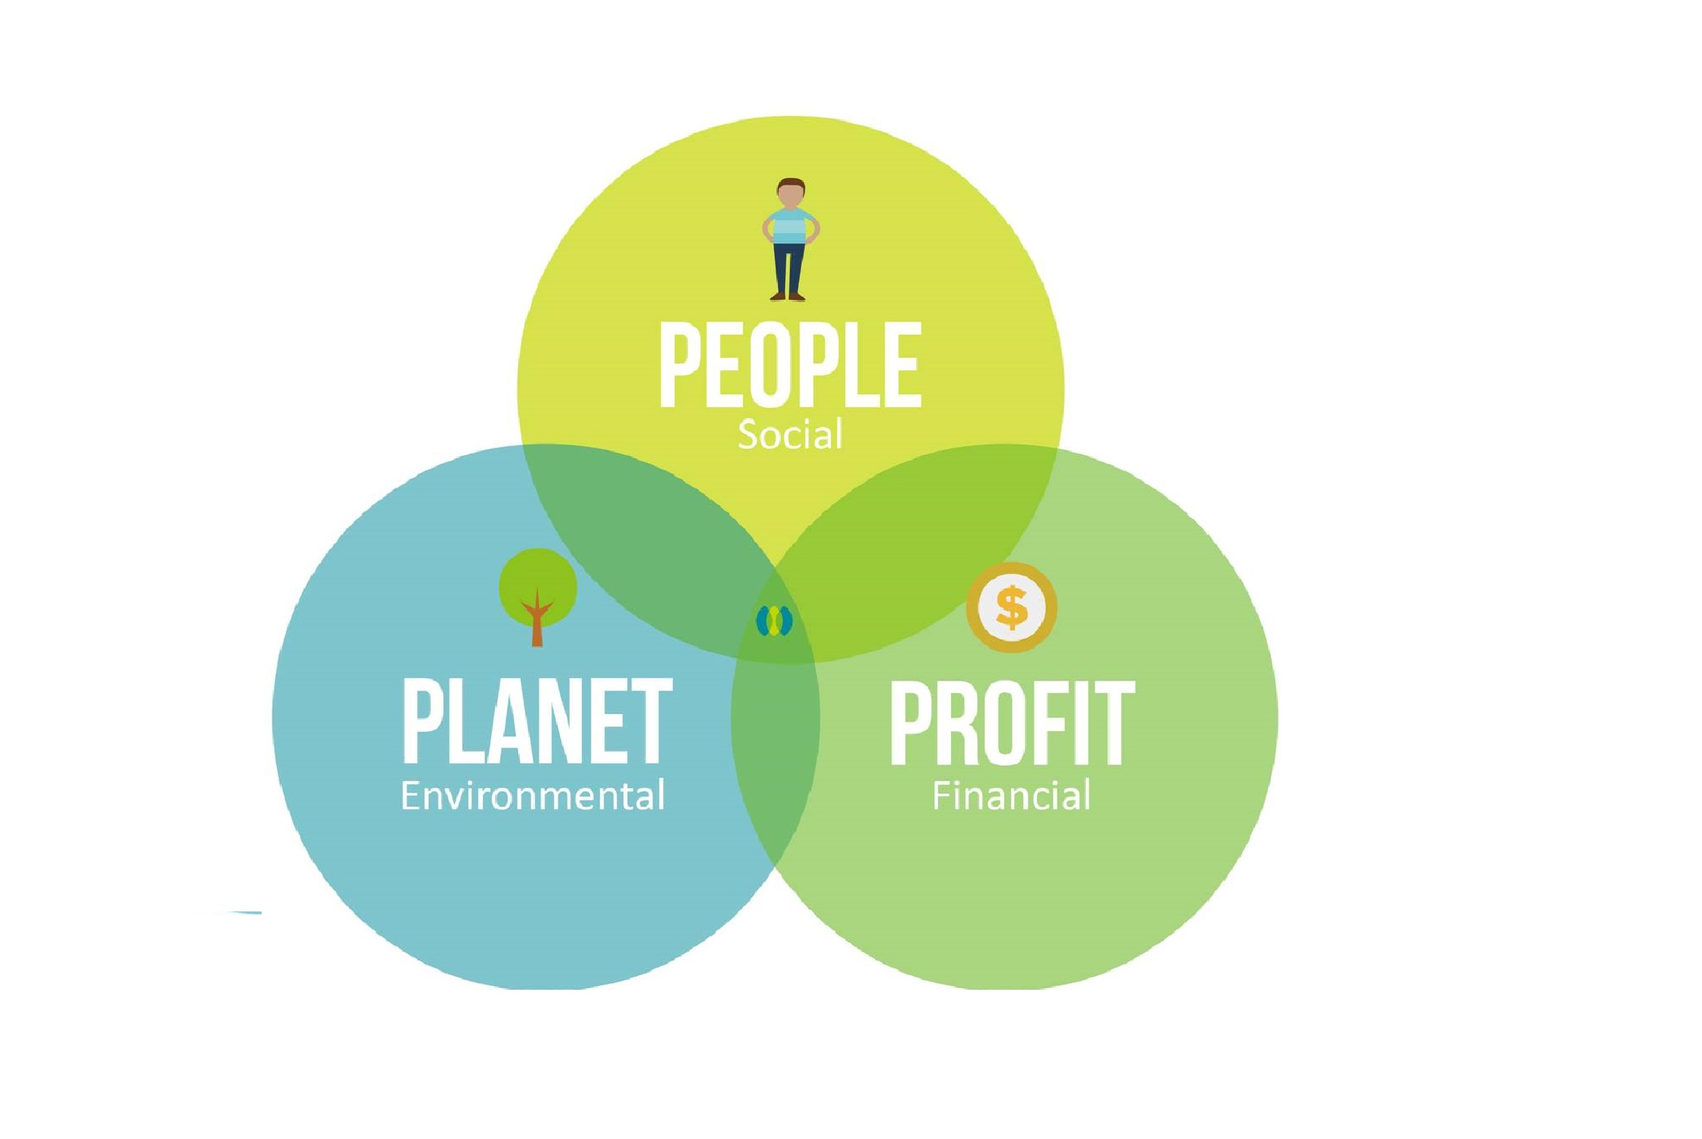
Why three pillars?

Slide 5
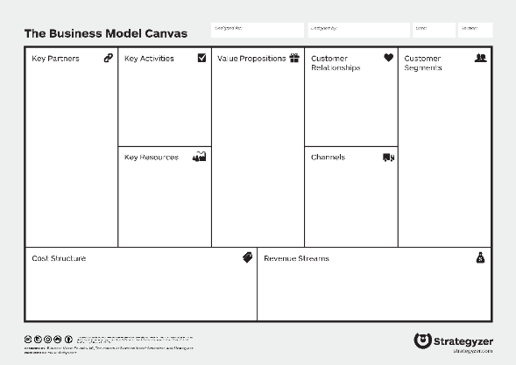
Two concepts combined into 3-PBM
Business Model Canvas
RPV (Resources-Processes-Values)
framework

Slide 6



57.100 employees
Net Income
24 B$
Revenue
90 B$

Slide 7


?
“…superior
business
model.”

Slide 8


Business model is
the rationale of how an organization creates, delivers and captures value

Slide 9
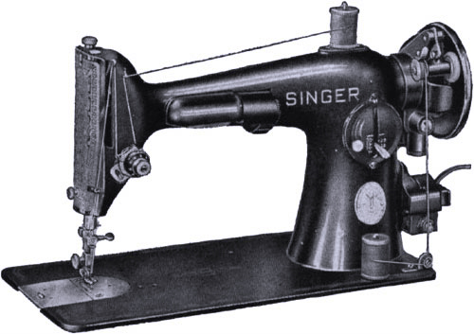
“Dollar down, dollar a week!”

Slide 10

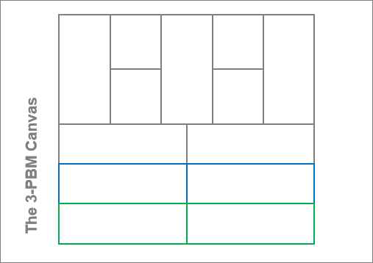
The Business Model Canvas.
It allows you to describe, design, challenge, invent,
and pivot your
business model.

Slide 11

Customer Segments
www.businessmodelgeneration.com

Slide 12

Value Proposition
www.businessmodelgeneration.com

Slide 13

Channels
www.businessmodelgeneration.com

Slide 14

Customer Relationships
www.businessmodelgeneration.com

Slide 15

Revenue Streams
www.businessmodelgeneration.com

Slide 16

Key Resources
www.businessmodelgeneration.com

Slide 17

Key Activities
www.businessmodelgeneration.com

Slide 18

Key Partners

Slide 19

Cost Structure

Slide 20
Business Model Canvas

Slide 21
Business Model Canvas

Slide 22
Business Model Story

Slide 23
Business model is
the rationale of how an organization creates, delivers and captures value

Slide 24
Impact
Commerce
Impact
Impact
Commerce
Commerce
Commerce
Commerce
Impact
Commerce
Commerce
Impact
Impact
Impact
Impact
Commerce
Impact
Commerce
Impact

Slide 25

Key partners
Key Activities
Value propositions
Customer Relationships
Customer Segments
Key Resources
Channels
Cost structure
Revenue streams
Societal Costs
Societal Benefits
Environmental Costs
Environmental Benefits

Slide 26
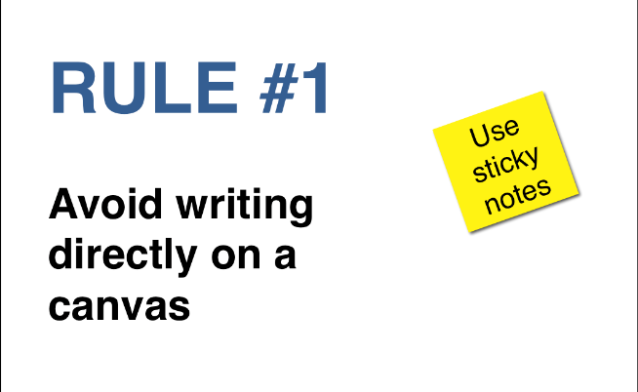
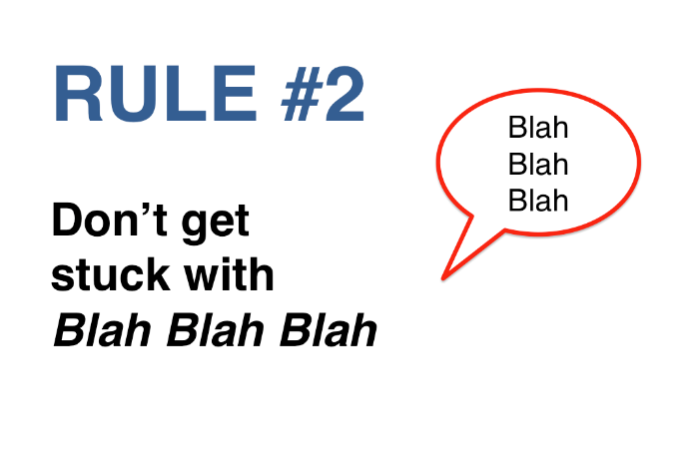
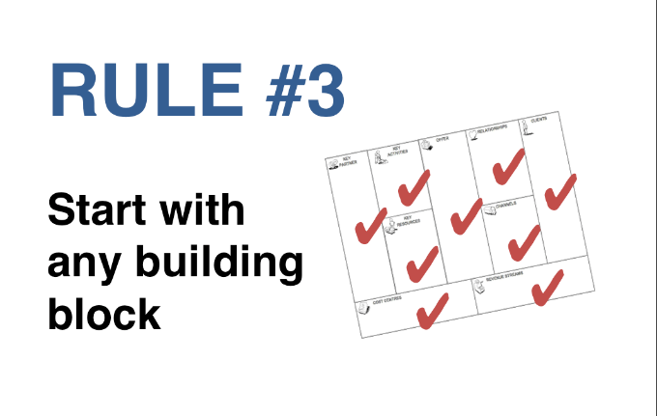
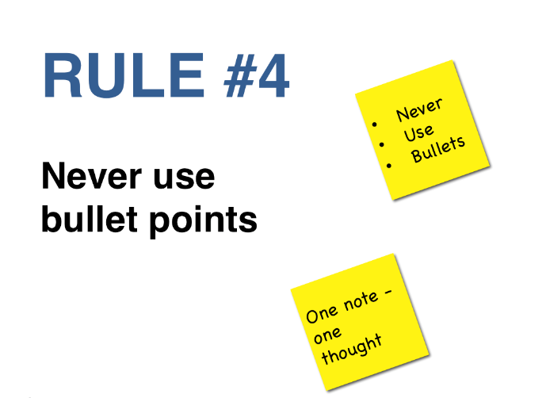
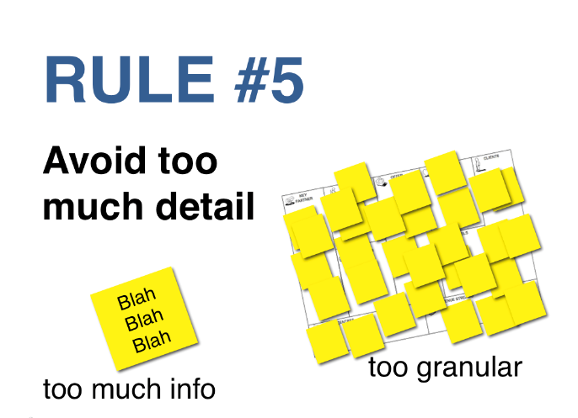
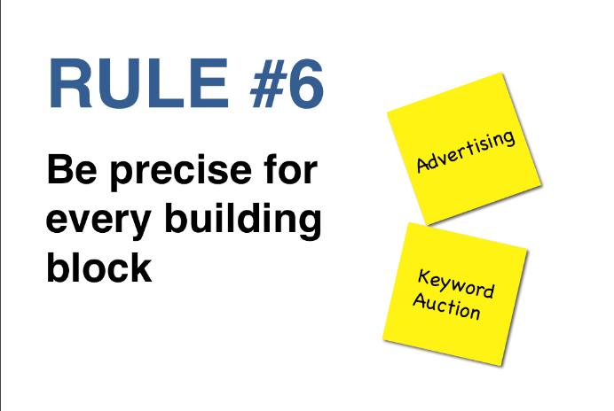
Ground Rules

Slide 27
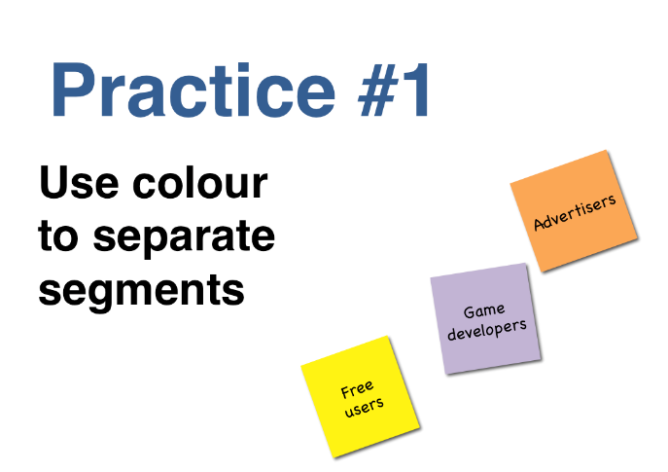
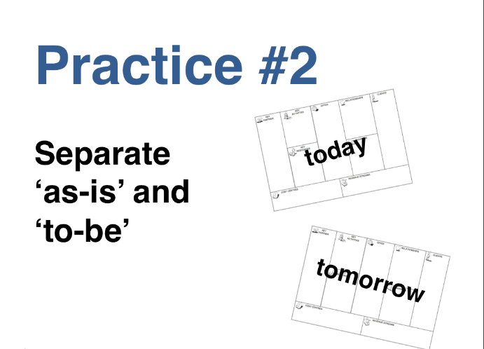
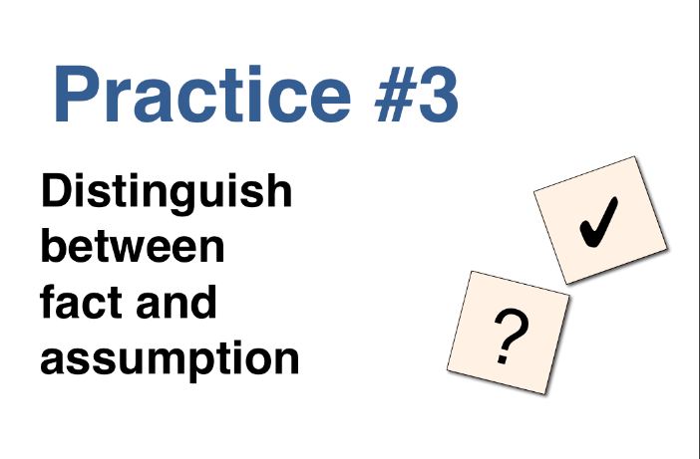

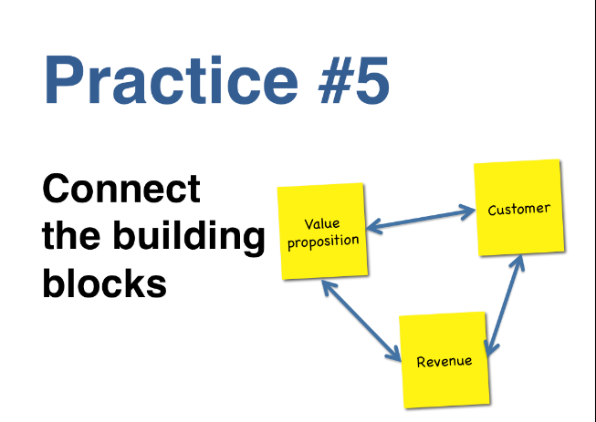
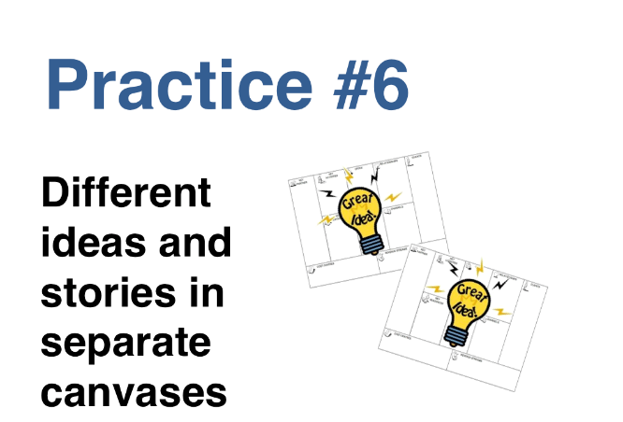
Best Practices

Slide 28
The RPV framework
Three classes or
sets of factors
that define what an organization can and cannot accomplish.

Slide 29
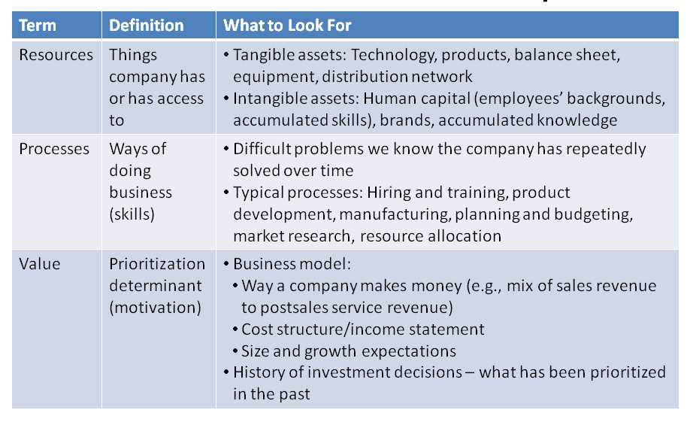
The RPV framework

Slide 30

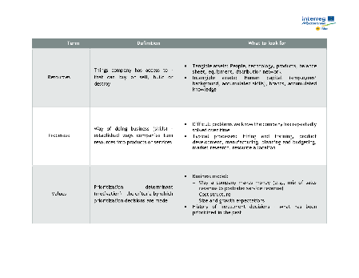
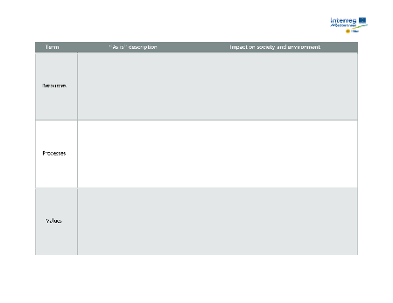
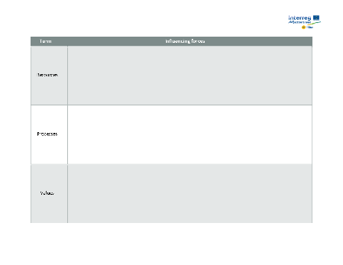
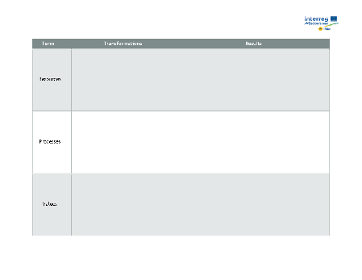
3-PBM key forms
RPV explanation & examples
Transformations
Results
RPV description “as is”
RPV impact on society
and environment
Influencing forces

Slide 31
BM corrections
Influencing forces
3PBM Cause
and effect
relationships
Economic BM
„as is”
RPV „as is”
Improvement
actions
Improved
3PBM draft
Performance
timeframe
R
P
V
R
P
V
R
P
V
R
P
V
R
P
V
T
L
Two perspectives
BM impact „as is”
RPV impact
on society &
environment
RPV trends
RPV transformations
and expected results
RPV „to be”
Test & Learn
1.
2.
3.
4.
5.
6.
Phase 1 Analysis
Phase 2 Improvement

Slide 32
BM corrections
Influencing forces
3PBM Cause
and effect
relationships
Economic BM
„as is”
RPV „as is”
Improvement
actions
Improved
3PBM draft
Performance
timeframe
R
P
V
R
P
V
R
P
V
R
P
V
R
P
V
T
L
Two perspectives
BM impact „as is”
RPV impact
on society &
environment
RPV trends
RPV transformations
and expected results
RPV „to be”
Test & Learn
1.
2.
3.
4.
5.
6.
Phase 1 Analysis
Phase 2 Improvement

Slide 33
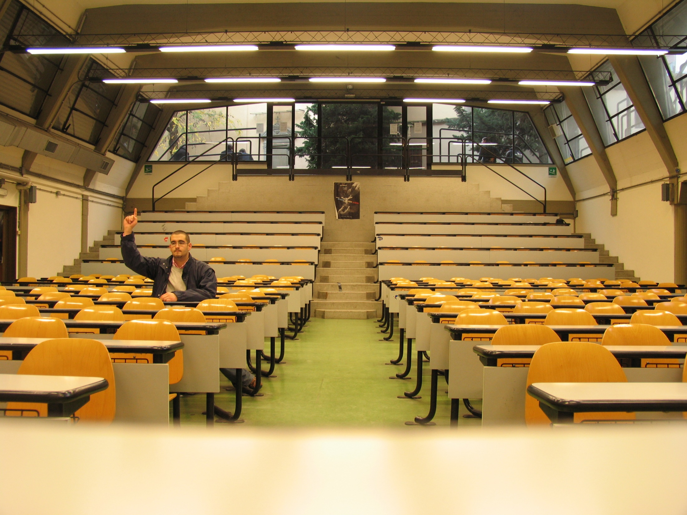
Discussion

Slide 34

Thank you.
Elements created by Boris Golob
bgolob@uniri.hr

Slide 35
3-PBM methodology
From Theory to Practice
Limassol 19.09.2019.
Michalis Maimaris & Philip Ammerman

Slide 36
Marina
Marina management
Personal
Sales
Berth
Customer support
Maintenance
www
Boat owners
Maintenance companies
Service companies
Concession
Marina
Restaurants
Service companies
Stores
Marina infrastructure
Business opportunity /
Space for rent
Fairs
Workforce
www
Infrastructure
Concession fee
Berth price
Rent
Wages
Maintenance price
www
Workforce
Sales
Stores
Concession
Berth
Boat owners
Berth price
Marina
Personal
Concession
Marina management
Maintenance companies
Infrastructure
Business opportunity /
Space for rent
Service companies
Maintenance
Rent
Fairs
www
Marina infrastructure
Customer support
Restaurants
Wages
Maintenance price

Slide 37
Marina
Marina management
Personel
Sales
Berth
Customer support
Maintenance
www
Boat owners
Maintenance companies
Service companies
Concession
Marina
Restaurants
Service companies
Stores
Marina infrastructure
Fairs
Business opportunity /
Space for rent
www
Workforce
Infrastructure
Concession fee
Berth price
Rent
Wages
Maintenance price
Employment opportunity
Local community integration
Seasonality
Limits development
„Immigrants”
Diversity
Pollution
Environmental protection
Reducing local community impact

Slide 38
Marine engine producer
R&D
Marine engines
(converted)
Engine producer
Manufacturing
1on1
Gearboxes, propellers, shafts…
Boat owners
Sailboat manufacturers
Manufacturing facility
Fairs
Skilled workforce
www
Technology
Regional representatives
Equipment
Wages
Engines and material
New engines and parts
Spare parts
Sailboat manufacturers
Marine engines
(converted)
New engines and parts
Regional representatives
1on1
Manufacturing facility
Manufacturing
Engine producer
Equipment
Boat owners
Gearboxes, propellers…
Spare parts
Fairs
Skilled workforce
R&D
Engines and material
www
Technology
Wages

Slide 39
Charter
Boats for rent
Boats for rent
Nautical turists
Fleet management
www
Sales
Boat owners
Boat owners
Boats
Personal 1on1
Distribution contract
Boat owners
Banks
Charter fleet
Charter / Fleet management
www
Skippers
Sailing school
Marina
Wannabe nautical tourists
Contracts with marinas
Fleet
Berth rent
Rent
Margin
Commission
Maintenance
Price
Nautical turists
Boats for rent
Rent
www
www
Charter fleet
Fleet management
Fleet
Marina
Sales
Berth rent
Skippers
Contracts with marinas
Maintenance
Personal 1on1
Boat owners
Charter / Fleet management
Commission
Boat owners
Boats for rent
Wannabe nautical tourists
Sailing school
Price
Boats
Boat owners
Margin
Distribution contract
Banks

Slide 40
Charter
Boats for rent
Boats for rent
Nautical turists
Fleet management
www
Fleet management
Sales
Boat owners
Boat owners
Boats
Personal 1on1
Boat owners
Distribution contract
Boat owners
Banks
Charter fleet
Charter / Fleet management
www
Skippers
Sailing school
Marina
Wannabe sailors
Contracts with marinas
Fleet
Berth rent
Rent
Price
Commission
Maintenance
Price
Nautical turists
Boats for rent
Rent
www
www
Charter fleet
Fleet management
Fleet
Marina
Sales
Berth rent
Skippers
Contracts with marinas
Maintenance
Concession
Personal 1on1
Concession
Rent

Slide 41
3-PBM methodology
Practical session
Limassol 19.09.2019.
Michalis Maimaris & Philip Ammerman

Slide 42
BM corrections
Influencing forces
3PBM Cause
and effect
relationships
Economic BM
„as is”
RPV „as is”
Improvement
actions
Improved
3PBM draft
Performance
timeframe
R
P
V
R
P
V
R
P
V
R
P
V
R
P
V
T
L
Two perspectives
BM impact „as is”
RPV impact
on society &
environment
RPV trends
RPV transformations
and expected results
RPV „to be”
Test & Learn
1.
2.
3.
4.
5.
6.
Phase 1 Analysis
Phase 2 Improvement

Slide 44
3-PBM key forms

Slide 45
3-PBM initial steps
Which BM elements impact society perspective?
Which BM elements impact environment perspective?
How? Why? – Speculate.

Slide 46
BM corrections
Influencing forces
3PBM Cause
and effect
relationships
Economic BM
„as is”
RPV „as is”
Improvement
actions
Improved
3PBM draft
Performance
timeframe
R
P
V
R
P
V
R
P
V
R
P
V
R
P
V
T
L
Two perspectives
BM impact „as is”
RPV impact
on society &
environment
RPV trends
RPV transformations
and expected results
RPV „to be”
Test & Learn
1.
2.
3.
4.
5.
6.
Phase 1 Analysis
Phase 2 Improvement

Slide 47
3-PBM key forms
RPV description “as is”
RPV impact on society
and environment

Slide 48
What to ask to identify values?
Without getting politically correct answers?
Decision making criteria? …procedures?
Attitudes toward customers, employees, environment?
Resource allocation criteria? Where do they invest, which areas?

Slide 49
BM corrections
Influencing forces
3PBM Cause
and effect
relationships
Economic BM
„as is”
RPV „as is”
Improvement
actions
Improved
3PBM draft
Performance
timeframe
R
P
V
R
P
V
R
P
V
R
P
V
R
P
V
T
L
Two perspectives
BM impact „as is”
RPV impact
on society &
environment
RPV trends
RPV transformations
and expected results
RPV „to be”
Test & Learn
1.
2.
3.
4.
5.
6.
Phase 1 Analysis
Phase 2 Improvement

Slide 50
3-PBM key forms
Influencing forces

Slide 51
Rationale for forces and trends
Forces and trends affecting economic perspective?
Forces and trends affecting society perspective influencing economic performance?
Forces and trends affecting environmental perspective influencing economic performance?

Slide 52
BM corrections
Influencing forces
3PBM Cause
and effect
relationships
Economic BM
„as is”
RPV „as is”
Improvement
actions
Improved
3PBM draft
Performance
timeframe
R
P
V
R
P
V
R
P
V
R
P
V
R
P
V
T
L
Two perspectives
BM impact „as is”
RPV impact
on society &
environment
RPV trends
RPV transformations
and expected results
RPV „to be”
Test & Learn
1.
2.
3.
4.
5.
6.
Phase 1 Analysis
Phase 2 Improvement

Slide 53
Cause and effect relationships
Speculate!
How BM/element change can improve society impact can improve economic impact?
How BM/element change can improve environmental impact can improve economic impact?

Slide 54
3-PBM key forms
Transformations
Results

Slide 55
Questions & Answers

