Slide 1



3-PBM methodology: from Theory to Practice
‘The Case of Cypriot Pilot Actions’
Limassol 19.09.2019
Philip Ammerman

Slide 2
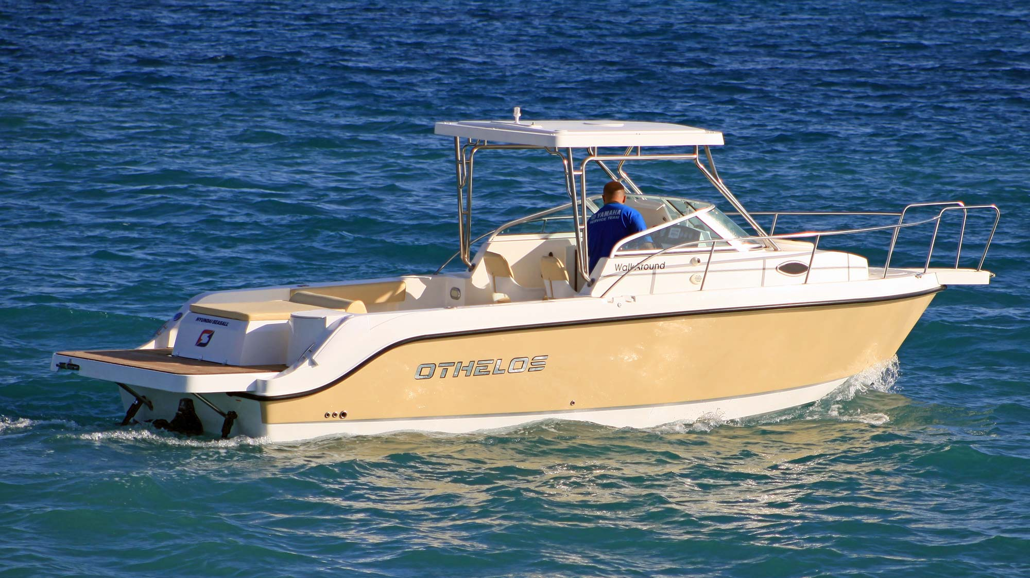

LESSONS LEARNED

Slide 3
iBLUE OBJECTIVES & OUTCOMES
OBJECTIVES
ACTIVITIES
OUTCOMES
Project participation as a subcontractor to the Cyprus Chamber of Commerce and Industry.
To identify a small enterprise in the Cyprus marine sector.
To implement the iBlue 3-PBM Methodology
To assess the overall impact on the company and assess results.
Yiotis Boats agrees to participate. Yiotis is one of 2 rigid hull power boat producers still operating in Cyprus.
Over a 3-month period, we implement joint activities to assess and analyse the company.
We find evidence of significant business model innovation designed to leverage company strengths while managing a difficult domestic economic environment.
Project participation has improved overall strategic awareness and positioning.
The links between sustainability and the overall project methodology would benefit from further work.
Small companies in this sector confront survival-level challenges: sustainability investments must prove their economic benefits if they are to be adapted in practice.

Slide 4
KEY DIMENSIONS
INTEGRATED MANUFACTURING MODEL
Company produced fiberglass hull powerboats using own molds and designs
High reliance on specialized network of subcontractors
Addition of powerboat engine from a related company
Seasonal manufacturing schedule to avoid high fixed costs
Capacity approximately 40 boats per year; current sales between 15-25
KEY CHALLENGES
Domestic market hit by 2013 economic crisis, euro-related hidden inflation and lower consumer disposable income: boats are now considered luxury items
Export costs high: cost and dimensions of container exports are prohibitive due to structural issues on shipping in Cyprus
BUSINESS MODEL & PRODUCT INNOVATION
The business model was changed to emphasize seasonal production and reliance on specialized subcontractors
Total revenue was increased by adding powerboat engine sales and maintenance
Business focus was changed to increase and enhance level of customization for professional customers (versus lifestyle family customers)

Slide 5
KEY BARRIERS: ROOT CAUSE ANALYSIS
Cyprus Financial Crisis (Haircuts/NPLs)
One Domestic Competitor
Low
Domestic Boat Sales
Low Consumer Credit
Low Disposable Income
High Housing Costs
High Container Transport Costs
Rising Taxes
Low
Turnover and Profitability
High Competition in Entry Segment
Low
Export Boat Sales
High Market Entry Costs
High Electricity Cost
High
Operating
Costs
High Import Cost
Rising Taxes

Slide 6
KEY OPPORTUNITIES
FINANCIAL INNOVATION
COMPETITIVE DIFFERENTIATION
Cyprus Financial Crisis (Haircuts/NPLs)
One Domestic Competitor
Low
Domestic Boat Sales
Low Consumer Credit
Low Disposable Income
DOMESTIC MARKETING
High Housing Costs
High Container Transport Costs
Rising Taxes
Low
Turnover and Profitability
High Competition in Entry Segment
Low
Export Boat Sales
BUSINESS MODEL INNOV
High Market Entry Costs
EXPORT MARKETING
High Electricity Cost
High
Operating
Costs
High Import Cost
Rising Taxes

Slide 7
KEY OPPORTUNITIES: HYPOTHESES
With better marketing, Cyprus Customers will remember YB
With better finance, Cyprus Customers can afford to purchase YB
More Cyprus Customers will purchase YB
Key Segments:
Families/Recreational / Yacht Tenders
Key USP: Customisation / Flexible Delivery Schedule / 2 Years Free Maintenance
Key Value Offer:
50% down payment
50% on credit card w/4-6 instals
Priority given to customers w/motor purchase
Key Indicators
15 Boats in 2019/20
18 Boats in 2020/21
22 Boats in 2021/2022
With better marketing, International Customers will learn about YB
With better value, International Customers will prefer YB
More International Customers will purchase YB
Key Segments:
Israel Dealers & Specialists
Yacht Tenders / Limassol Marina / Ayia Napa Marina
Key Value:
High Customisation
High Quality
Safe Supplier / Low Tax Supplier
Key Indicators
5 Boats in 2019/20
7 Boats in 2020/21
8 Boats in 2021/2022
Hypotheses link to the RPV Model

Slide 8
BUSINESS SUSTAINABILITY INDICATORS
Units Sold | 2018/19 | 2019/20 | 2020/21 | 2021/22
Personal Boats |  | 15 | 15 | 20
Recreational Boats |  | 5 | 10 | 10
Total Units |  | 20 | 25 | 30
Sales Area | 2018/19 | 2019/20 | 2020/21 | 2021/22
Cyprus |  | 15 | 18 | 22
Export |  | 5 | 7 | 8
Export Share |  | 25% | 28% | 27%
Units Sold w/Finance | 2018/19 | 2019/20 | 2020/21 | 2021/22
# Units |  | 5 | 8 | 10
Share |  | 25% | 32% | 33%
Units Sold by Online | 2018/19 | 2019/20 | 2020/21 | 2021/22
# Units |  | 2 | 4 | 6
Share |  | 10% | 16% | 20%

Slide 9
BMC FOLLOWING TRANSFORMATION
Key Partners
Key Activities
Value
Proposition
Customer
Relationships
Customer
Segments
Partner Co
To be determined
Marketing & Sales
Design & Production
Sales & Delivery
Sales Financing
After-Sales Service
Managing Staff
Production Planning
High quality, low-cost fiber-glass hull boats with long durability
Design suited to the Mediterranean environment
Excellent outboard motors with low maintenance
Highly professional after-sales service and maintenance
Sales Financing
Best Warranty in Class
Primary Sales
After-Sales Service: Boats
After-Sales Service: Motors
Refit & Repair
Sales Finance
Professional Marine Companies (Diving Schools, Paragliding, other)
Individual Boat Owners
Key Resources
Customer
Channels
Ship Captains (for tender repair)
Limassol Factory
Technical Staff
Excellent Market Reputation
Direct Sales
Referrals
Limassol Boat Show
Internet
Other Promotion
Foreign Sales Agents and Sales Referrors
Cost Structure
Revenue Streams
Fixed Costs
Seasonal Production Costs
Variable Costs
(Per Boat)
Admin & Overhead Costs
Initial Boat Sales w/Accessories
Yamaha Motor Sales
After-Sales Service
Boat Refit and Repair
(3rd Party)
Financing Cost
Financing Income

Slide 10
KEY ISSUES FOR 3-PBM MODEL
The selection of companies informs their ability to implement this model. Most small companies work experientially, not strategically.
When confronted by a theoretical model promoting sustainability, enterprise managers need evidence of the tangible benefit offered by the model. There needs to be a clear link between environmental and social sustainability and profitability for a company.
Many companies are already paying a high price for mandated environmental or social services (e.g. Green Point, GESY) and do not see a quality or quantity benefit, or are confronted by the need to double-pay services.
The methodological links between the BCM, RPV and the 3-PBM Model need to be further established. BCM and RPV examine the status-quo in a superficial manner. The Manufacturing Sustainability Index provides for a very wide range of detailed indicators that are either input linked (not output-oriented) or often beyond the capacity of small manufacturing firms to realistically address.
The relevance of other strategic management and analysis models, such as the Balanced Scorecard, should be reviewed for relevance to small enterprises and the ease of implementation.
Evidence from other projects, sectors and economic cycles shows that in an economic downturn, or a period of high competitiveness, companies that have made sustainability a key to their business model often face higher volatility effects, as their customers seek cheaper solutions. What are the true costs and benefits of sustainability over multiple business cycles?
This could be a highly useful solution for governments seeking to understand the competitiveness of local manufacturing industry.
Additional work is needed to ensure there are practical and tangible benefits for small enterprises.
Additional methodological work would strengthen the quality of results.

Slide 11
PHILIP AMMERMAN
Philip is a consultant, entrepreneur and investment advisor who has advised start-ups, investors and enterprises on digital disruption, internationalisation and investment-led growth since 1994. He is founder of Navigator Consulting, Numenor Capital and the Centre for Innovation & Entrepreneurship.
He has advised on over 120 investment transactions with a total investment value exceeding € 6 billion. He has multi-sectoral experience in due diligence, business planning and financial modelling, in sectors including digital/tech start-ups and scale-ups, agri-food, manufacturing and hospitality.
In 2010, he founded the Navigator Entrepreneurship Charter, an initiative to support growth in Europe by investing in 10 new start-ups and spin-offs between 2010 and 2020.
In 2019, he was appointed as Team Coordinator for Greece by the European Bank for Reconstruction and Development (EBRD), and is supporting innovative Greek companies in the field of competitiveness and internationalisation. Projects are underway for Mastihashop, an innovative food, cosmetics and parapharmaceuticals firm and Milkplan, an innovative dairy equipment manufacturer.
Philip acts as regional portfolio manager for Brookstreet Equity Partners, a London-based private equity firm active in tech and innovation investments. Brookstreet recently announced its first investment in Greece, in the nanotechnology firm Nanophos.
He is a non-executive director of Redfin Capital, an asset management firm, and is an evaluator for the European Commission's Horizon 2020 SME Instrument. In Spring 2019, Philip was appointed as Entrepreneur in Residence at the University of Cyprus, Centre for Entrepreneurship.
Philip studied at Princeton University and Cornell University’s School of Industrial and Labour Relations. He is also a graduate of YCombinator’s Startup School and the Oxford Fintech Programme.

